Slide 1
FULL PARAMETER FINE-TUNING FOR LARGE LANGUAGE MODELS WITH LIMITED RESOURCES
-Kai Lv, Yuqing Yang, Tengxiao Liu, Qinghui Gao, Qipeng Guo, Xipeng Qiu
Dhruval Bhuva
Aniket Kulkarni
Meghashree
Vishwa Rajput

Slide 2
Points to be covered
Introduction
Related work
Methods
Experiments
Conclusion

Slide 3
Introduction
Revolution of NLP with LLMs:
NLP transformed by Large Language Models (LLMs), demanding massive GPU resources.
Lowering the threshold for LLMs training crucial for wider participation.
Challenges:
Existing approaches focus on parameter-efficient fine-tuning.
Full parameter fine-tuning demands substantial GPU resources, limiting accessibility.
Proposed Solution - LOMO:
Introducing LOw-Memory Optimization (LOMO) for memory-efficient training.
Reduces memory usage to 10.8%, enabling full parameter fine-tuning on a single machine.

Slide 4
Related work
Activation Checkpointing: Purpose: Reduce memory overhead during backpropagation. Approach: Strategically store selected activations, reducing memory to the square root with minimal extra computation.
Mixed-Precision Training: Benefits: Accelerate training speed and reduce memory footprint. Strategies: Full-precision copies, loss scaling, and specific arithmetic operations for stability.
Heterogeneous Training: Goal: Reduce GPU memory consumption using CPU and NVMem. Strategies: Layer-to-layer tensor transfer, ZeRO-Offload, and ZeRO-Infinity for efficient memory utilization.

Slide 5
Methods
Use SGD as an optimizer instead of modern optimizers like Adam
Smoother loss surface
SGD has drawback of large curvature loss surface but in this case the parameter space of LLM is smooth
Small change will not change loss too much
So, loss surface of LLMs should not have a large curvature
Note: it is applicable only in training of LLMs NLP based tasks, synthetic loss function unrelated to pre-training tasks will indeed face the large curvature problem
Local optimum: The goal - fine tuning can be achieved with local optimum as well because changing model is not required
Distant saddle points: This problem may not be encountered as parameters are not changed from the pre trained value

Slide 6
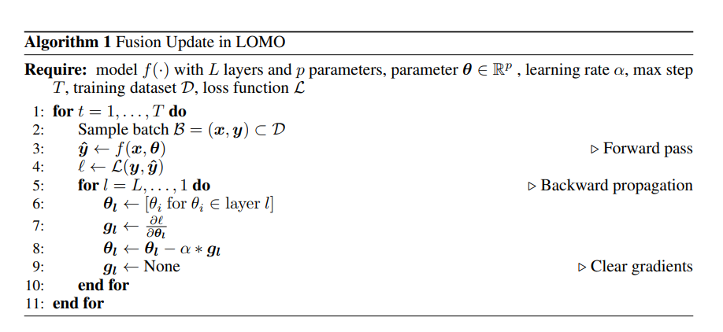

Slide 7
Implicit batch size
Utilizing SGD optimizer over a smooth loss surface would imply a larger batch size.
The loss surface of LLMs is smooth, and a larger batch size indicates stronger training stability, so fine tuning process of LLMs with the SGD optimizer is stable.

Slide 8
Memory Overhead Challenge:
Deep learning frameworks store gradient tensors, causing significant memory usage.
LOMO Approach:
LOMO (Low-Memory Optimization) proposes a strategy to fuse gradient computation and parameter update, reducing the need to store gradient tensors.
Implementation and Impact:
LOMO employs hook functions for immediate parameter updates, reducing memory usage.
Compatible with parameter-efficient fine-tuning (PEFT), enabling efficient training with minimal memory overhead.

Slide 9
Gradient Handling Alternatives:
Proposed alternatives to gradient normalization and clipping.
Options include clipping gradient tensors by values and an additional pass for gradient norm computation.
Clipping Strategies:
Clipping by values effective for gradient explosion, recommended for learning rates less than 1e−3.
Concerns about directional changes at high learning rates.
Gradient Norm Computation:
Challenge in computing gradient norm due to simultaneous parameter updates.
Introducing an additional pass balances gradient norm computation without additional memory usage but at the expense of speed.
Controversial Grouped Clipping:
Controversial solution: Approximating the norm using parameter groups, introducing dynamic learning rates for each group.
Potential future direction to adapt learning rates to different parameter groups in Stochastic Gradient Descent (SGD), suggested for exploration.

Slide 10
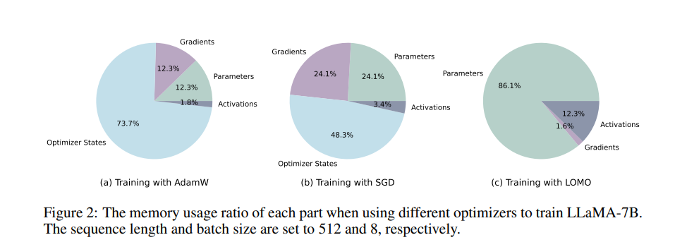
The memory usage ratio of each part when using different optimizers to train LLaMA-7B. The sequence length and batch size are set to 512 and 8, respectively.

Slide 11
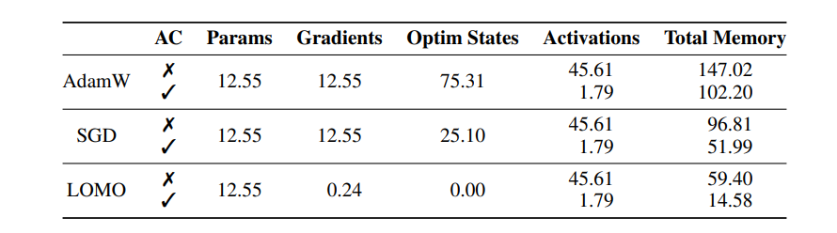
Memory usage (GB) when training LLaMA-7B under different settings. AC refers to Activation Checkpointing. The sequence length and batch size are set to 512 and 8, respectively.

Slide 12
Mixed-Precision Training for Speed:
Commonly used to accelerate training processes.
Dynamic Loss Scaling:
Counteracts precision degradation during FP16 (half-precision) training.
Magnifies the loss before the backward pass and diminishes gradients by the same factor.
Integration with LOMO:
Dynamic loss scaler integrated with Low-Memory Optimization (LOMO) to adjust the scaling factor dynamically.
Scale factor doubled if no overflow in a specified number of backward passes; halved otherwise.
Simultaneous execution with gradient normalization, involving two backward passes: one to identify overflow and another to update parameters.
Handling Operations for Full Precision:
Convert gradient and associated parameters to full precision within computations, such as normalization and scaling, for effective updates and gradient handling.

Slide 13
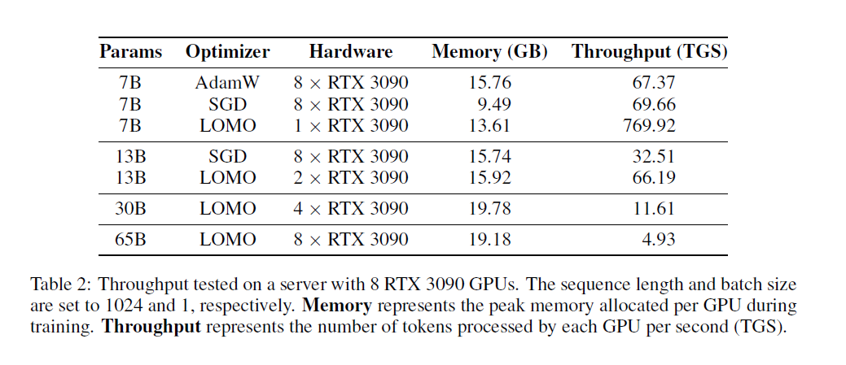
Experiments
LOMO is a novel optimizer demonstrating significant speed improvements for training large language models (LLMs).
It outperforms AdamW and SGD by 2x with 30B parameters and 4x with 65B parameters.
Additionally, LOMO is 1.5x faster than OPT-137, a recently proposed optimizer.
These findings highlight LOMO's promise as an efficient optimizer, especially for LLMs with extensive parameter counts.

Slide 14
Experiments
MEMORY PROFILE
LOMO Memory Efficiency: LOMO significantly reduces memory usage during LLaMA-7B model training. Memory footprint decreases from 102.20GB to 14.58GB, outperforming AdamW and SGD.
Optimizer States Optimization: AdamW configuration allocates 73.7% of memory to optimizer states. LOMO eliminates the need for optimizer state memory, enhancing efficiency.
Gradient and Activation Memory Reduction: LOMO immediately updates parameters upon receiving gradients, reducing memory consumption. Activation checkpointing with LOMO decreases activation-related memory from 45.61GB to 1.79GB.

Slide 15
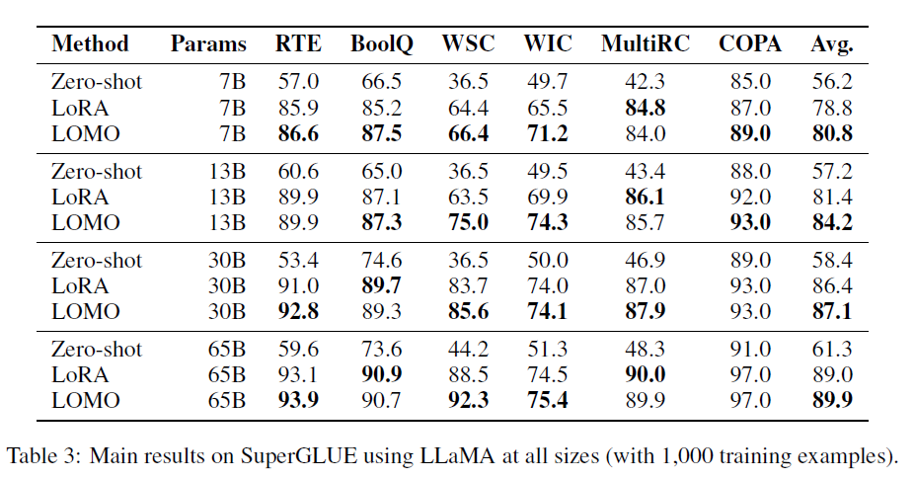
Experiments
THROUGHPUT
Experimental Setup: Evaluated on a server with 8 RTX 3090 GPUs. Throughput measured in TGS using ZeRO-3.
LOMO vs. AdamW and SGD: LOMO excels in throughput, outperforming AdamW / SGD. Achieves 4.93 TGS for a 65B model.
Efficiency and Reduction: Enables single-GPU training for 7B models. 65B model training in 3.6 hours on 8 GPUs.
Optimizer Comparison and Gains: LOMO consistently outperforms other optimizers. Substantial efficiency gains over OPT-137.
Overall Impact: LOMO emerges as a top optimizer for large language models. Demonstrates efficiency across various model sizes.

Slide 16
Experiments
DOWNSTREAM PERFORMANCE
Comparison of Fine-Tuning Methods: Evaluated LOMO's effectiveness in fine-tuning large language models. Compared against Zero-shot and LoRA, a popular parameter-efficient fine-tuning technique.
SuperGLUE Dataset Evaluation: Used the SuperGLUE dataset for assessing model performance. Focused on specific tasks such as RTE, BoolQ, WSC, WIC, MultiRC, and COPA.
Experimental Details: Conducted experiments following the methodology of MeZO (Malladi et al., 2023). Randomly sampled 1000 training and test data, reporting best results with the same seed. Utilized consistent prompts and hyperparameters detailed in Appendix-A. Performance evaluation based on Accuracy as the metric.

Slide 17
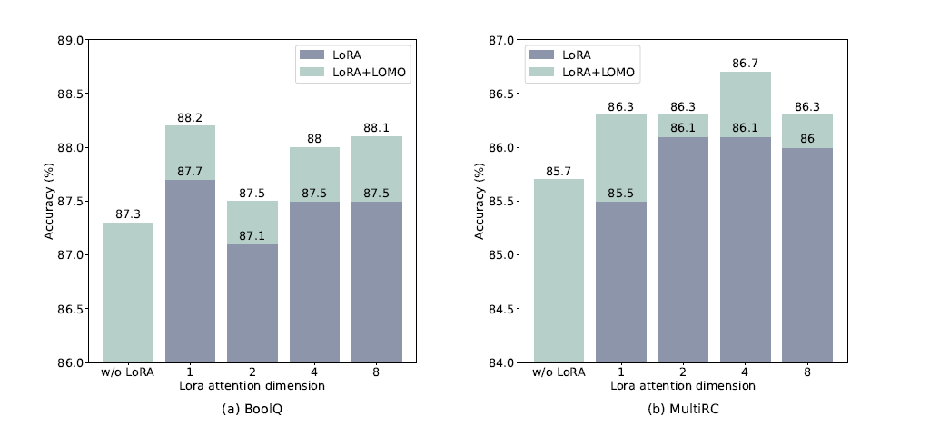
Experiments
MAIN RESULTS
Fine-tuning Superiority: LOMO consistently outperforms Zero-shot, achieving average gains of over 20 points with LLaMA-13B across six datasets. Highlights the significant performance enhancements fine-tuning provides over zero-shot settings.
Comparison with LoRA: LOMO generally surpasses LoRA, showing average gains of 2.8 points with LLaMA-13B. Indicates that full-parameter fine-tuning, as employed by LOMO, contributes more to performance improvement compared to parameter-efficient fine-tuning.
Scalability and Efficiency: LOMO efficiently scales up to 65 billion parameter models, maintaining strong performance even with resource constraints. Strikes a balance between performance and efficiency, making it a competitive choice for optimizing large language models.

Slide 18
Experiments
LORA WITH LOMO
Independence of LOMO and LoRA: Experimental validation using LLaMA-13B on BoolQ and MultiRC datasets confirms that LOMO and LoRA are fundamentally independent. Despite the already higher results achieved by LoRA, LOMO consistently enhances LoRA's performance.
Complementary Roles: LOMO and LoRA serve complementary roles in the fine-tuning process. LOMO focuses on fine-tuning pre-trained model weights, while LoRA tunes additional modules. This distinction allows them to work together synergistically without compromising each other's effectiveness.
Improved Model Tuning: LOMO's integration with LoRA results in better model tuning for downstream tasks. The combined approach capitalizes on the strengths of each method, leading to enhanced overall performance without trade-offs.

Slide 19
Conclusion
Innovative Solution - LOMO: Introduced LOMO for efficient full parameter fine-tuning in resource-limited settings.
Impactful Results and Feasibility: Successfully fine-tuned a 65B model on RTX3090 GPUs, showcasing LOMO's ability to reduce memory usage without compromising performance.
Future Focus and Ongoing Exploration: Direction: Explore parameter quantization for lower resource thresholds, expanding LOMO's applicability. Next Steps: Investigate additional scenarios for LOMO application and conduct theoretical analyses for large language model optimization.

